Slide 1
Regression Analysis
By
Dr. E. Sivasankar
CSE Department
NIT, Trichy

Slide 2
Regression Analysis
Regression analysis attempts to explain the influence that a set of variables has on the outcome of another variable of interest. Often, the outcome variable is called a dependent variable because the outcome depends on the other variables.
These additional variables are sometimes called the input variables or the independent variables.

Slide 3
Overview of Regression
Regression analysis is useful for answering the following kinds of questions:
● What is a person’s expected income?
● What is the probability that an applicant will default on a loan?
Linear regression is a useful tool for answering the first question, and logistic regression is a popular method for addressing the second.

Slide 4
Linear Regression
Linear regression is an analytical technique used to model the relationship between several input variables and a continuous outcome variable.
A key assumption is that the relationship between an input variable and the outcome variable is linear.
Although this assumption may appear restrictive, it is often possible to properly transform the input or outcome variables to achieve a linear relationship between the modified input and outcome variables.

Slide 5
Linear Regression Use cases
● Real estate:
A simple linear regression analysis can be used to model residential home prices as a function of the home’s living area.
Such a model helps set or evaluate the list price of a home on the market.
The model could be further improved by including other input variables such as number of bathrooms, number of bedrooms, lot size, school district rankings, crime statistics, and property taxes.

Slide 6
Linear Regression Use cases
● Demand forecasting:
Businesses and governments can use linear regression models to predict demand for goods and services.
For example, restaurant chains can appropriately prepare for the predicted type and quantity of food that customers will consume based upon the weather, the day of the week, whether an item is offered as a special, the time of day, and the reservation volume.
Similar models can be built to predict retail sales, emergency room visits, and ambulance dispatches.

Slide 7
Linear Regression Use cases
● Medical :
A linear regression model can be used to analyze the effect of a proposed radiation treatment on reducing tumor sizes.
Input variables might include duration of a single radiation treatment, frequency of radiation treatment, and patient attributes such as age or weight

Slide 8
Model Description
The linear regression model assumes that there is a linear relationship between the input variables and the outcome variable. This relationship can be expressed as shown in Equation 6-1.
where:
y is the outcome variable
x j are the input variables, for j = 1, 2, …, p – 1
β0 is the value of y when each x j equals zero
βj is the change in y based on a unit change in x j, for j = 1, 2, …, p – 1
ε is a random error term that represents the difference in the linear model and a particular observed value for y

Slide 9
Model Description
Suppose it is desired to build a linear regression model that estimates a person’s annual income as a function of two variables—age and education—both expressed in years.
In this case, income is the outcome variable, and the input variables are age and education
However, it is also obvious that there is considerable variation in income levels for a group of people with identical ages and years of education.
This variation is represented by ε in the model. So, in this example, the model would be expressed as shown in Equation 6-2.

Slide 10
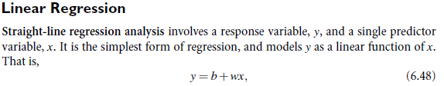


Slide 11
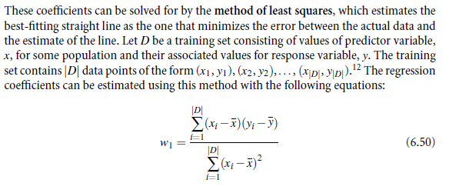

Slide 12
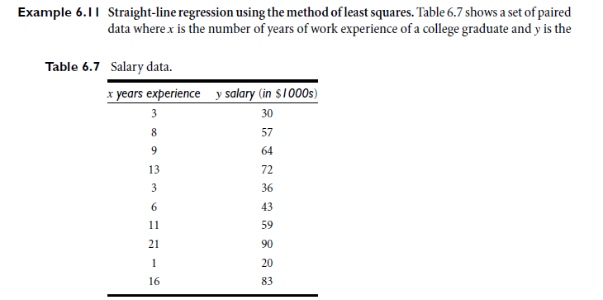

Slide 13
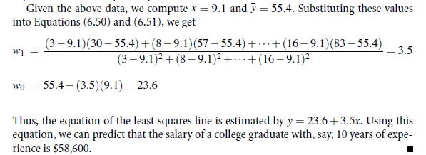

Slide 14
Linear Regression in R Programming
Regression analysis is a very widely used statistical tool to establish a relationship model between two variables.
One of these variable is called predictor variable whose value is gathered through experiments. The other variable is called response variable whose value is derived from the predictor variable.
In Linear Regression these two variables are related through an equation, where exponent (power) of both these variables is 1.
Mathematically a linear relationship represents a straight line when plotted as a graph. A non-linear relationship where the exponent of any variable is not equal to 1 creates a curve.

Slide 15
R - Linear Regression
The general mathematical equation for a linear regression is
y = ax + b Following is the description of the parameters used.
where
y is the response variable.
x is the predictor variable.
a and b are constants which are called the coefficients.

Slide 16
Linear Regression in R Programming
lm() Function
This function creates the relationship model between the predictor and the response variable.
Syntax
The basic syntax for lm() function in linear regression is
lm(formula,data)
Following is the description of the parameters used −
formula is a symbol presenting the relation between x and y.
data is the vector on which the formula will be applied.

Slide 17
Linear Regression in R Programming
Create Relationship Model & get the Coefficients
x <- c(151, 174, 138, 186, 128, 136, 179, 163, 152, 131)
y <- c(63, 81, 56, 91, 47, 57, 76, 72, 62, 48)
# Apply the lm() function.
relation <- lm(y~x)
print(relation)
When we execute the above code, it produces the following result −Call:
lm(formula = y ~ x)
Coefficients:
(Intercept) x
-38.4551 0.6746

Slide 18
Multiple regression
Multiple regression is an extension of linear regression into relationship between more than two variables.
In simple linear relation we have one predictor and one response variable, but in multiple regression we have more than one predictor variable and one response variable.

Slide 19
Multiple regression
Multiple regression is an extension of linear regression into relationship between more than two variables.
In simple linear relation we have one predictor and one response variable, but in multiple regression we have more than one predictor variable and one response variable.

Slide 20
Multiple regression
The general mathematical equation for multiple regression is
y = a + b1x1 + b2x2 +...bnxn
Following is the description of the parameters used −
y is the response variable.
a, b1, b2...bn are the coefficients.
x1, x2, ...xn are the predictor variables.
We create the regression model using the lm() function in R. The model determines the value of the coefficients using the input data. Next we can predict the value of the response variable for a given set of predictor variables using these coefficients

Slide 21
Multiple regression
The general mathematical equation for multiple regression is
y = a + b1x1 + b2x2 +...bnxn
Following is the description of the parameters used −
y is the response variable.
a, b1, b2...bn are the coefficients.
x1, x2, ...xn are the predictor variables.
We create the regression model using the lm() function in R. The model determines the value of the coefficients using the input data. Next we can predict the value of the response variable for a given set of predictor variables using these coefficients

Slide 22
Multiple regression
lm() Function
This function creates the relationship model between the predictor and the response variable.
Syntax
The basic syntax for lm() function in multiple regression is −
lm(y ~ x1+x2+x3...,data)
Following is the description of the parameters used −
formula is a symbol presenting the relation between the response variable and predictor variables.
data is the vector on which the formula will be applied.

Slide 23
Multiple regression
lm() Function
This function creates the relationship model between the predictor and the response variable.
Syntax
The basic syntax for lm() function in multiple regression is −
lm(y ~ x1+x2+x3...,data)
Following is the description of the parameters used −
formula is a symbol presenting the relation between the response variable and predictor variables.
data is the vector on which the formula will be applied.

Slide 24
Multiple regression
Example
Input Data
Consider the data set "mtcars" available in the R environment. It gives a comparison between different car models in terms of mileage per gallon (mpg), cylinder displacement("disp"), horse power("hp"), weight of the car("wt") and some more parameters.
The goal of the model is to establish the relationship between "mpg" as a response variable with "disp","hp" and "wt" as predictor variables. We create a subset of these variables from the mtcars data set for this purpose.

Slide 25
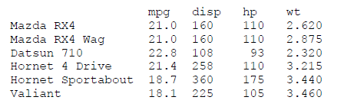
Multiple regression
input <- mtcars[,c("mpg","disp","hp","wt")]
print(head(input))
When we execute the above code, it produces the following result −

Slide 26
Multiple regression
input <- mtcars[,c("mpg","disp","hp","wt")]
# Create the relationship model.
model <- lm(mpg~disp+hp+wt, data = input)
# Show the model.
print(model)
# Get the Intercept and coefficients as vector elements.
cat("# # # # The Coefficient Values # # # ","\n")
a <- coef(model)[1]
print(a)
Xdisp <- coef(model)[2]
Xhp <- coef(model)[3]
Xwt <- coef(model)[4]
print(Xdisp)
print(Xhp)
print(Xwt)

Slide 27
Multiple regression
When we execute the above code, it produces the following result −
Call: lm(formula = mpg ~ disp + hp + wt, data = input)
Coefficients:
(Intercept) disp hp wt
37.105505 -0.000937 -0.031157 -3.800891
# # # # The Coefficient Values
# # # (Intercept)
37.10551
disp
-0.0009370091
hp
-0.03115655
wt
-3.800891

Slide 28
Logistic Regression
In linear regression modeling, the outcome variable is a continuous variable.
In the earlier Income example, linear regression can be used to model the relationship between age and education to income.
Suppose a person’s actual income was not of interest, but rather whether someone was wealthy or poor.
In such a case, when the outcome variable is categorical in nature, logistic regression can be used to predict the likelihood of an outcome based on the input variables

Slide 29
Logistic Regression
For example, a logistic regression model can be built to determine if a person will or will not purchase a new automobile in the next 12 months.
The training set could include input variables for a person’s age, income, and gender as well as the age of an existing automobile. The training set would also include the outcome variable on whether the person purchased a new automobile over a 12-month period.
The logistic regression model provides the likelihood or probability of a person making a purchase in the next 12 months

Slide 30
Logistic Regression Use cases
● Medical:
Develop a model to determine the likelihood of a patient’s successful response to a specific medical treatment or procedure. Input variables could include age, weight, blood pressure, and cholesterol levels.

Slide 31
Logistic Regression Use cases
● Finance:
Using a loan applicant’s credit history and the details on the loan, determine the probability that an applicant will default on the loan. Based on the prediction, the loan can be approved or denied, or the terms can be modified.

Slide 32
Logistic Regression Use cases
● Marketing:
Determine a wireless customer’s probability of switching carriers (known as churning) based on age, number of family members on the plan, months remaining on the existing contract, and social network contacts.
With such insight, target the high-probability customers with appropriate offers to prevent churn.

Slide 33
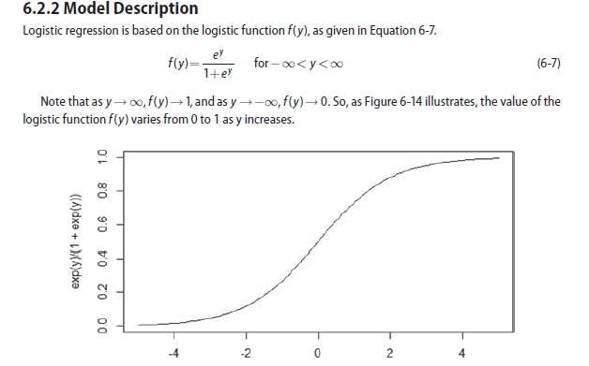
Logistic Regression

Slide 34
Logistic Regression
Because the range of f (y) is (0, 1), the logistic function appears to be an appropriate function to model the probability of a particular outcome occurring.
As the value of y increases, the probability of the outcome occurring increases.
In any proposed model, to predict the likelihood of an outcome, y needs to be a function of the input variables.
In logistic regression, y is expressed as a linear function of the input variables.
In other words, the formula shown in Equation 6-8 applies

Slide 35
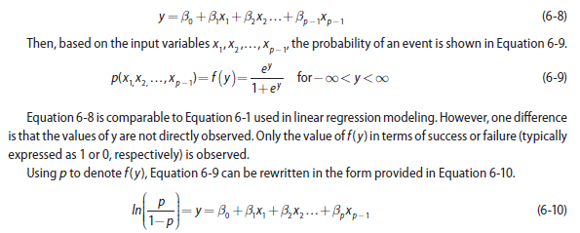
Logistic Regression

Slide 36
Logistic Regression
The Logistic Regression is a regression model in which the response variable (dependent variable) has categorical values such as True/False or 0/1.
It actually measures the probability of a binary response as the value of response variable based on the mathematical equation relating it with the predictor variables.

Slide 37
Logistic Regression
The general mathematical equation for logistic regression is −
y = 1/(1+e^-(a+b1x1+b2x2+b3x3+...))
Following is the description of the parameters used −
y is the response variable.
x is the predictor variable.
a and b are the coefficients which are numeric constants.
The function used to create the regression model is the glm() function

Slide 38
Logistic Regression
Syntax
The basic syntax for glm() function in logistic regression is −
glm(formula ,data ,family)
Following is the description of the parameters used −
formula is the symbol presenting the relationship between the variables.
data is the data set giving the values of these variables.
family is R object to specify the details of the model. It's value is binomial for logistic regression.

Slide 39
Logistic Regression
Syntax
The basic syntax for glm() function in logistic regression is −
glm(formula ,data ,family)
Following is the description of the parameters used −
formula is the symbol presenting the relationship between the variables.
data is the data set giving the values of these variables.
family is R object to specify the details of the model. It's value is binomial for logistic regression.

Slide 40
Logistic Regression
Example
The in-built data set "mtcars" describes different models of a car with their various engine specifications.
In "mtcars" data set, the transmission mode (automatic or manual) is described by the column am which is a binary value (0 or 1).
We can create a logistic regression model between the columns "am" and 3 other columns - hp, wt and cyl.

Slide 41
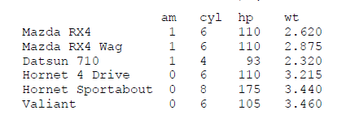
Logistic Regression
# Select some columns form mtcars.
input <- mtcars[,c("am","cyl","hp","wt")]
print(head(input))
When we execute the above code, it produces the following result −

Slide 42
Logistic Regression
Create Regression Model
We use the glm() function to create the regression model and get its summary for analysis
input <- mtcars[,c("am","cyl","hp","wt")]
am.data = glm(formula = am ~ cyl + hp + wt, data = input,
family = binomial)
print(summary(am.data))

Slide 43
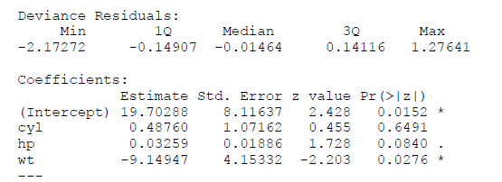
Logistic Regression
When we execute the above code, it produces the following result −
Call:glm(formula = am ~ cyl + hp + wt, family = binomial, data = input)

Slide 44
Thank You

